Slide 1
CSC 131: Software Engineering
Team Name: Interactive Interface
Group Members: Cheng Thor, Daniel Komac, Isaac Israel, Justin Rucker

Slide 2
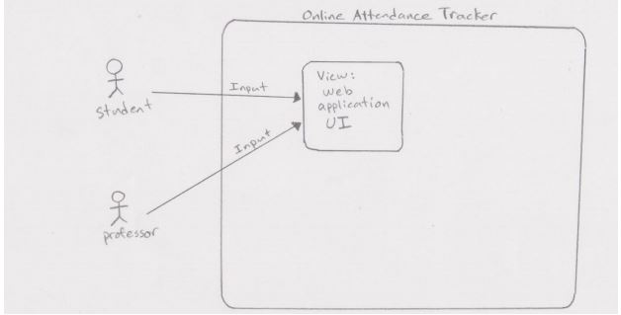
System Diagram:

Slide 3
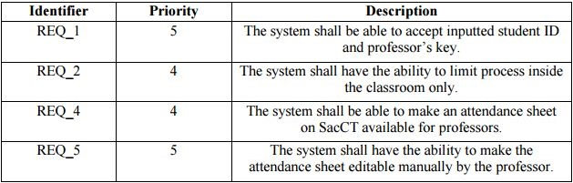
Functional Requirements:

Slide 4
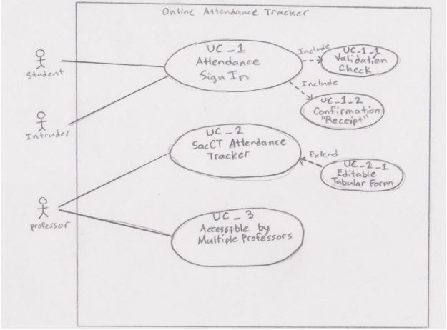
Use Case Diagram

Slide 5
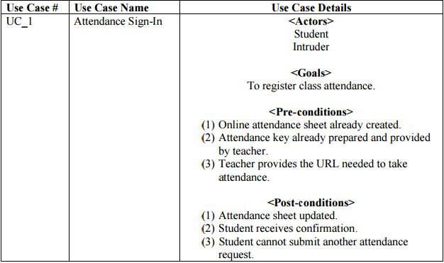
Use Case Descriptions:
Use Case 1: Attendance Log-In

Slide 6
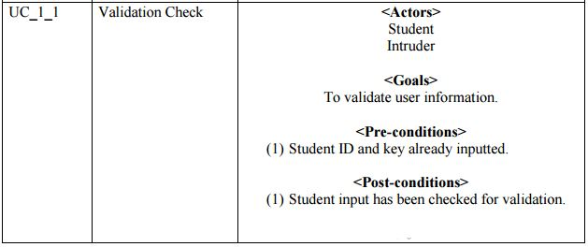
Use Case 1_1: Validation Check

Slide 7
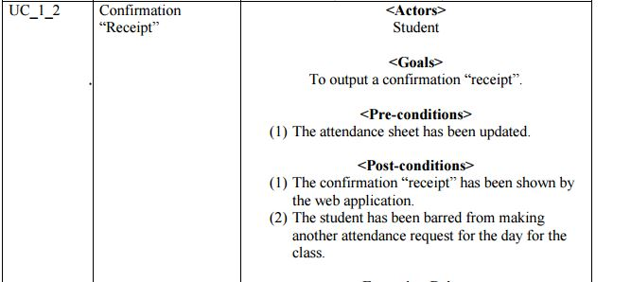
Use Case 1_2: Confirmation of Attendance

Slide 8
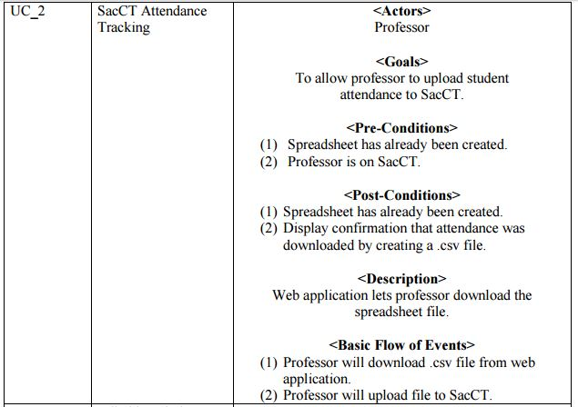
Use Case 2: SacCT Attendance Tracking

Slide 9
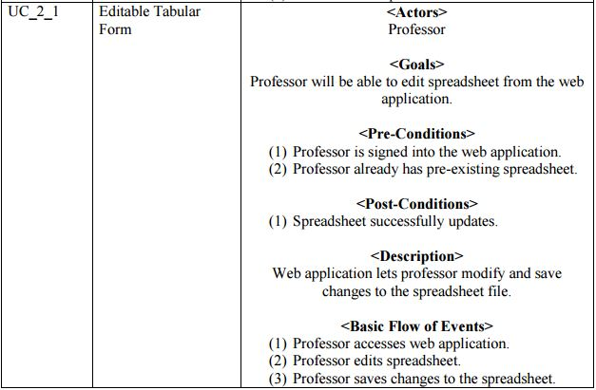
Use Case 2_1: Editable Tabular Form

Slide 10
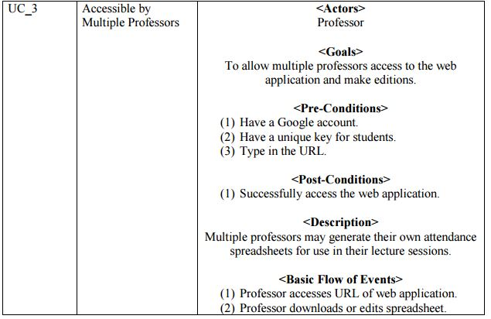
Use Case 3: Professor Accessibility

Slide 11
Example of Site:
http://athena.ecs.csus.edu/~israeli/

